Slide 1
ETL Data Pipeline with Python & Snowflake
A hands-on data engineering challenge focused on data extraction, cleansing, and cloud integration
Eesa Hassan
11/06/2025

Slide 2
Agenda
Challenge Overview
Preparation
Task-by-Task Breakdown
Learnings & Reflections
Final Thoughts

Slide 3
Challenge Overview
Purpose of the Challenge
Wrong Title?
My Strategic Approach
Notes:
Explain what the challenge is about and how you planned to tackle it.

Slide 4
Purpose of this challenge
This ETL Data Pipeline challenge is part of my recruitment process for a Data Engineering apprenticeship with Digital Native. The project tasks me with building an end-to-end data workflow—from data extraction and cleaning to loading into Snowflake—using tools and concepts that are completely new to me.
The purpose of this challenge is to assess my ability to quickly learn and apply new technical skills, my attention to detail, and how effectively I can leverage generative AI to support my learning journey. Completing this project demonstrates my commitment and readiness to grow as a data engineer in a remote working environment.

Slide 5
Wrong title?
I noticed that the title of the challenge document refers to an ‘AI Churn Model Challenge’, while the file name is ‘python-snowflake-data-engineering-challenge-v0.1.pdf’ and the main body focuses on a data quality pipeline.
My first thought were that you wanted me to create a churn prediction model without explicitly telling me. However, after considering that this is a data engineering apprenticeship and uploading the data set, task objectives/overview, and expected completion time to ChatGPT, the most possible reason for this is to test my attention to detail.
ChatGPT problem diagnoses:
This dataset only contains car listings, not user behavior over time, so you’d need to join this data with user interaction logs to train a true churn model.
I used AI to produce a professional title after prompting it with key words to include and ended up with ETL Data Pipeline with Python & Snowflake.

Slide 6
My strategic approach
Planned, Structured, and Focused
Read and mapped the entire challenge before writing any code
Created a step-by-step task plan with daily goals and milestones
Documented as I Built
Used PowerPoint notes (temporary) to explain my thinking and actions throughout the challenge
Captured screenshots and reflections as I progressed — no last-minute rush
Leveraged AI Effectively
Used ChatGPT and GitHub Copilot for code suggestions, clarification, and error resolution
Always tested, verified, and customized AI outputs to suit the task
Treated AI as a collaborative assistant, not a shortcut
Built the PowerPoint Early
Created a structured slide deck template from the start
Updated slides task-by-task and polished everything at the end for clarity and professionalism

Slide 7

Preparation

Slide 8
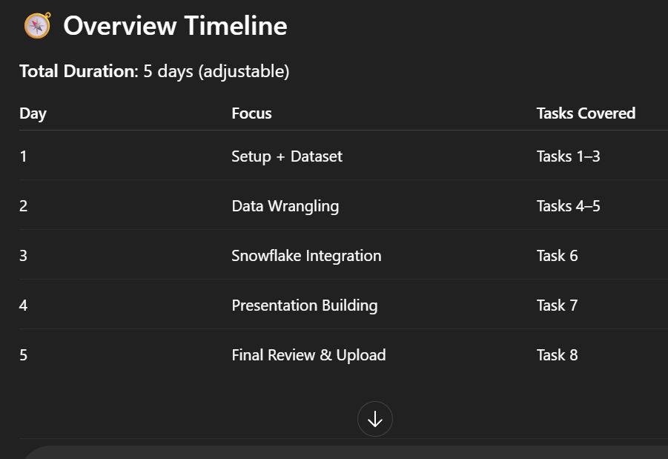
Creating Timeline
I uploaded the challenge PDF to ChatGPT and ran this prompt; ‘make me a detailed timeline/plan for this task’
This was my base guidance for the challenge
(I’ve only attached a screenshot of the timeline overview)

Slide 9
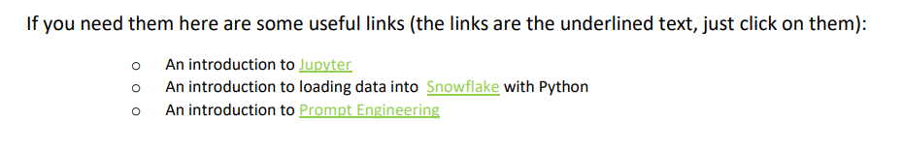
Read-up
I always like to have a basic understanding of what tools I’m working with and how they work before I utilise them which is why I have made it a habit to do research on anything prior to usage, be it tech related or not.
I used the recommended links in the pdf as well as ChatGPT to explain the core concepts.

Slide 10
Creating basic pptx template
I created a basic PowerPoint template using GAI to start.
The idea was to document as I progress and polish at the end.
I find this method is much more efficient and less mistake prone.

Slide 11
Task 1: Anaconda & Jupyter Setup
Read through tutorial
Screenshot of Anaconda and Jupyter installed
Miniconda install
Proof of Pandas library check

Slide 12
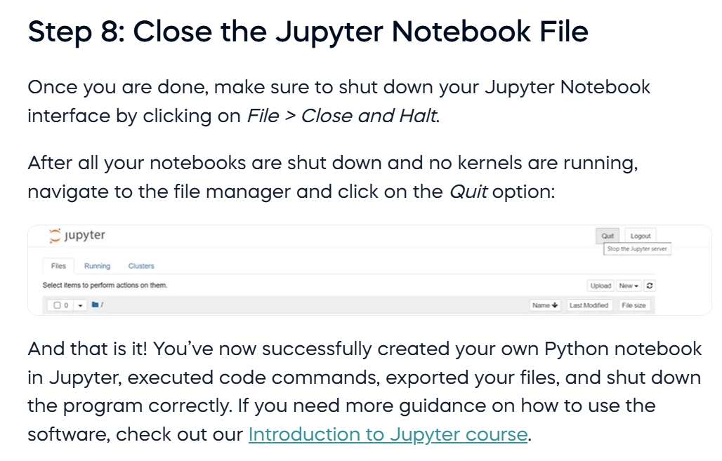
completing Jupyter Tutorial

Slide 13
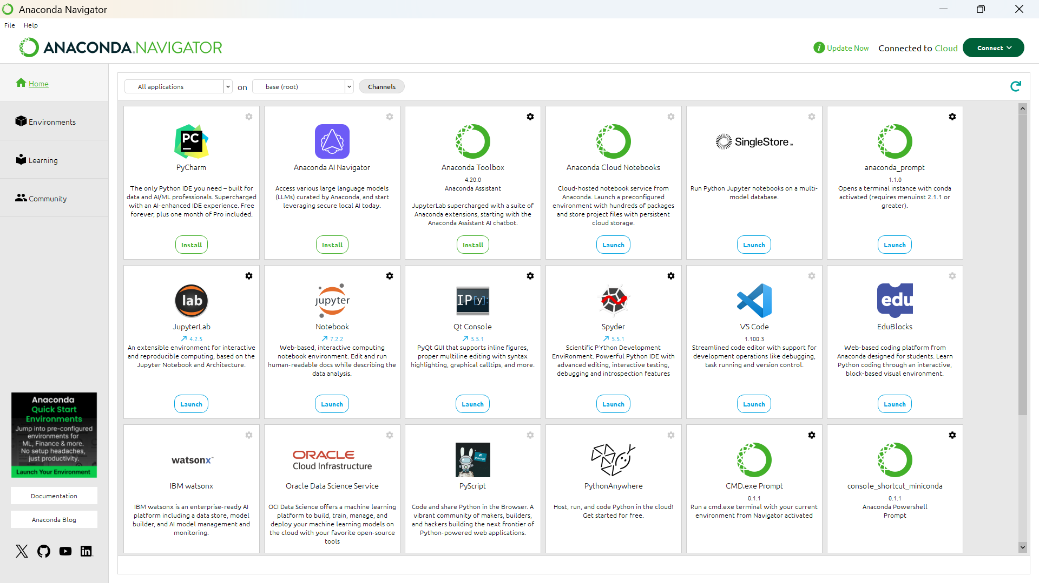
Anaconda with jupyter installed (windows)

Slide 14
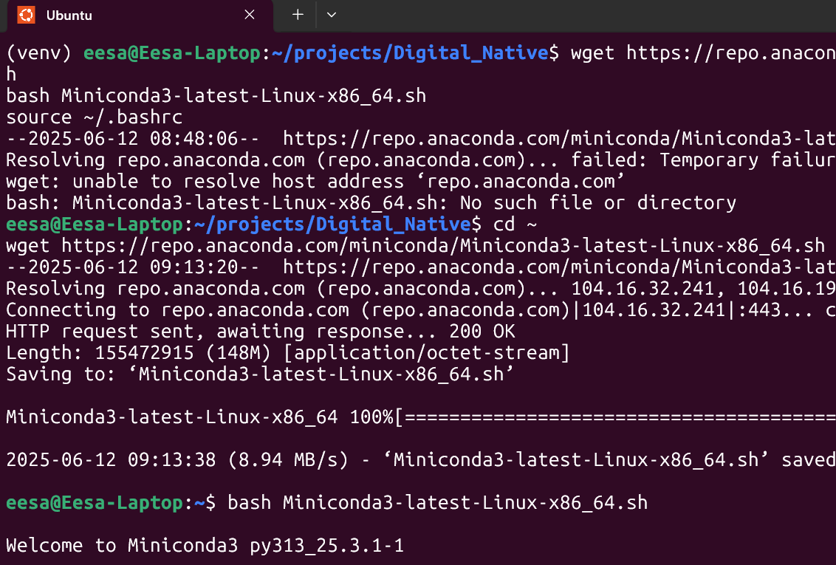
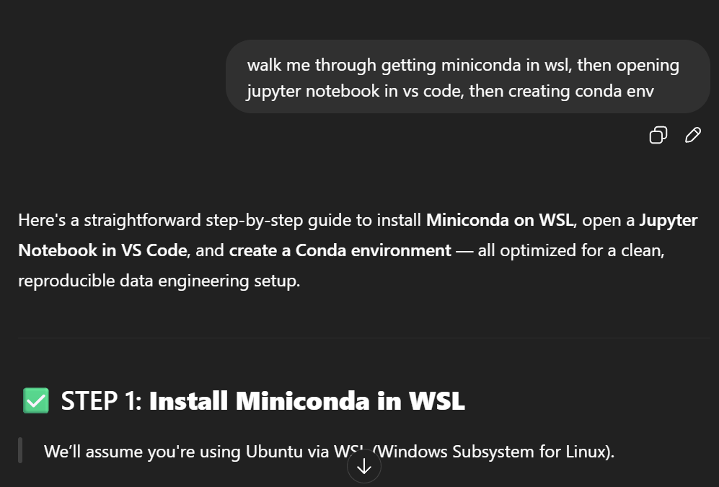
Miniconda install (WSL)
Notice I used a chain of commands in my prompt, it’s actually a very useful technique called ‘chain of thought’, designed to give AI direction.
Technique sourced from the ‘introduction to prompt engineering’ article I read earlier
See Task 7; ‘Problems and Fixes’ for why I installed miniconda in WSL

Slide 15
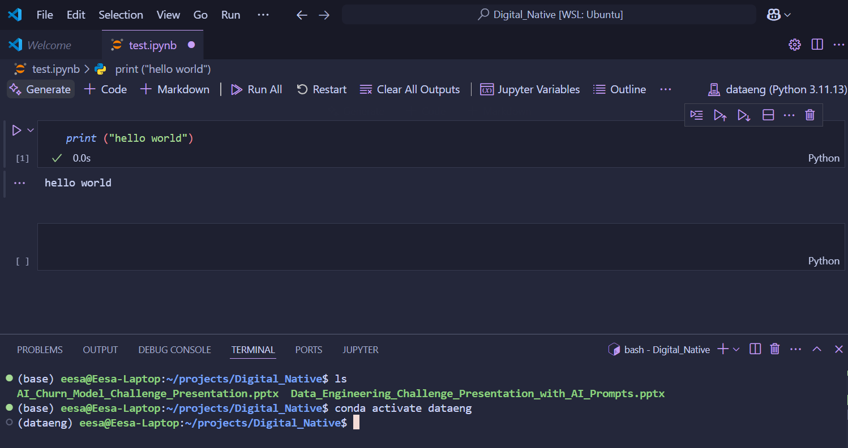
Opening jupyter notebook in Vs code

Slide 16
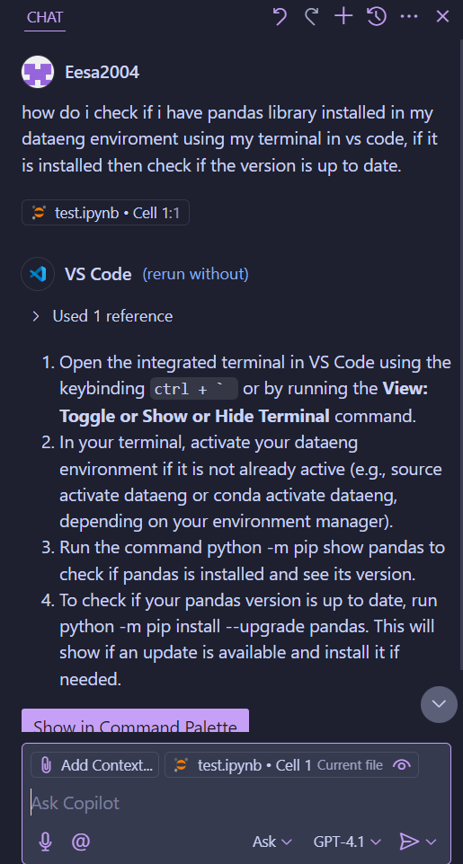
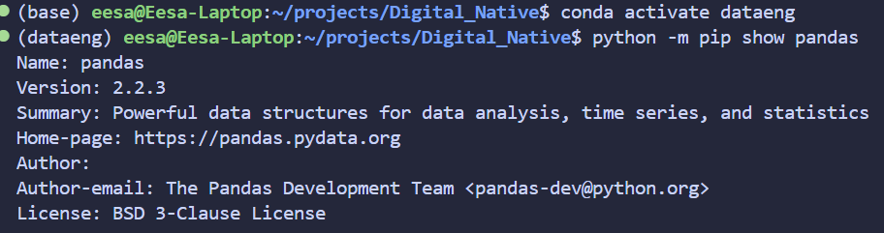
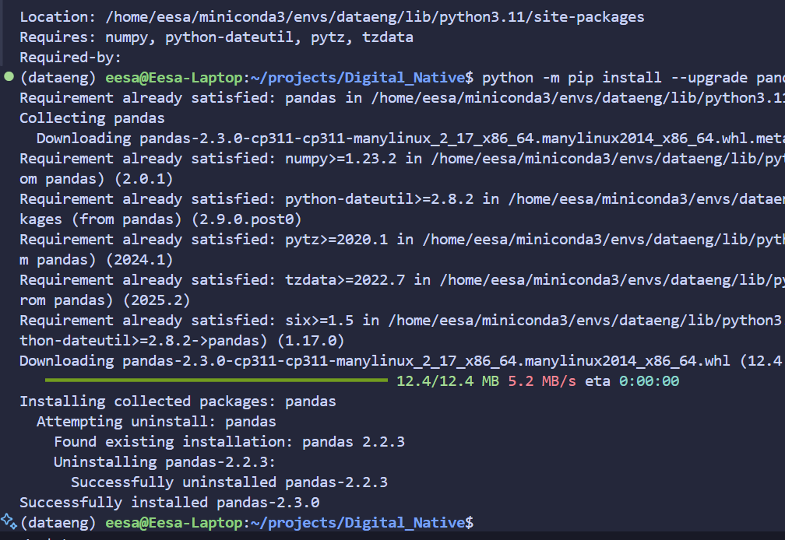
Pandas library check
(Asking Copilot)

Slide 17
Task 2: Data Importing/ Downloading
Dataset Source
Stretch: Importing directly into Jupyter

Slide 18
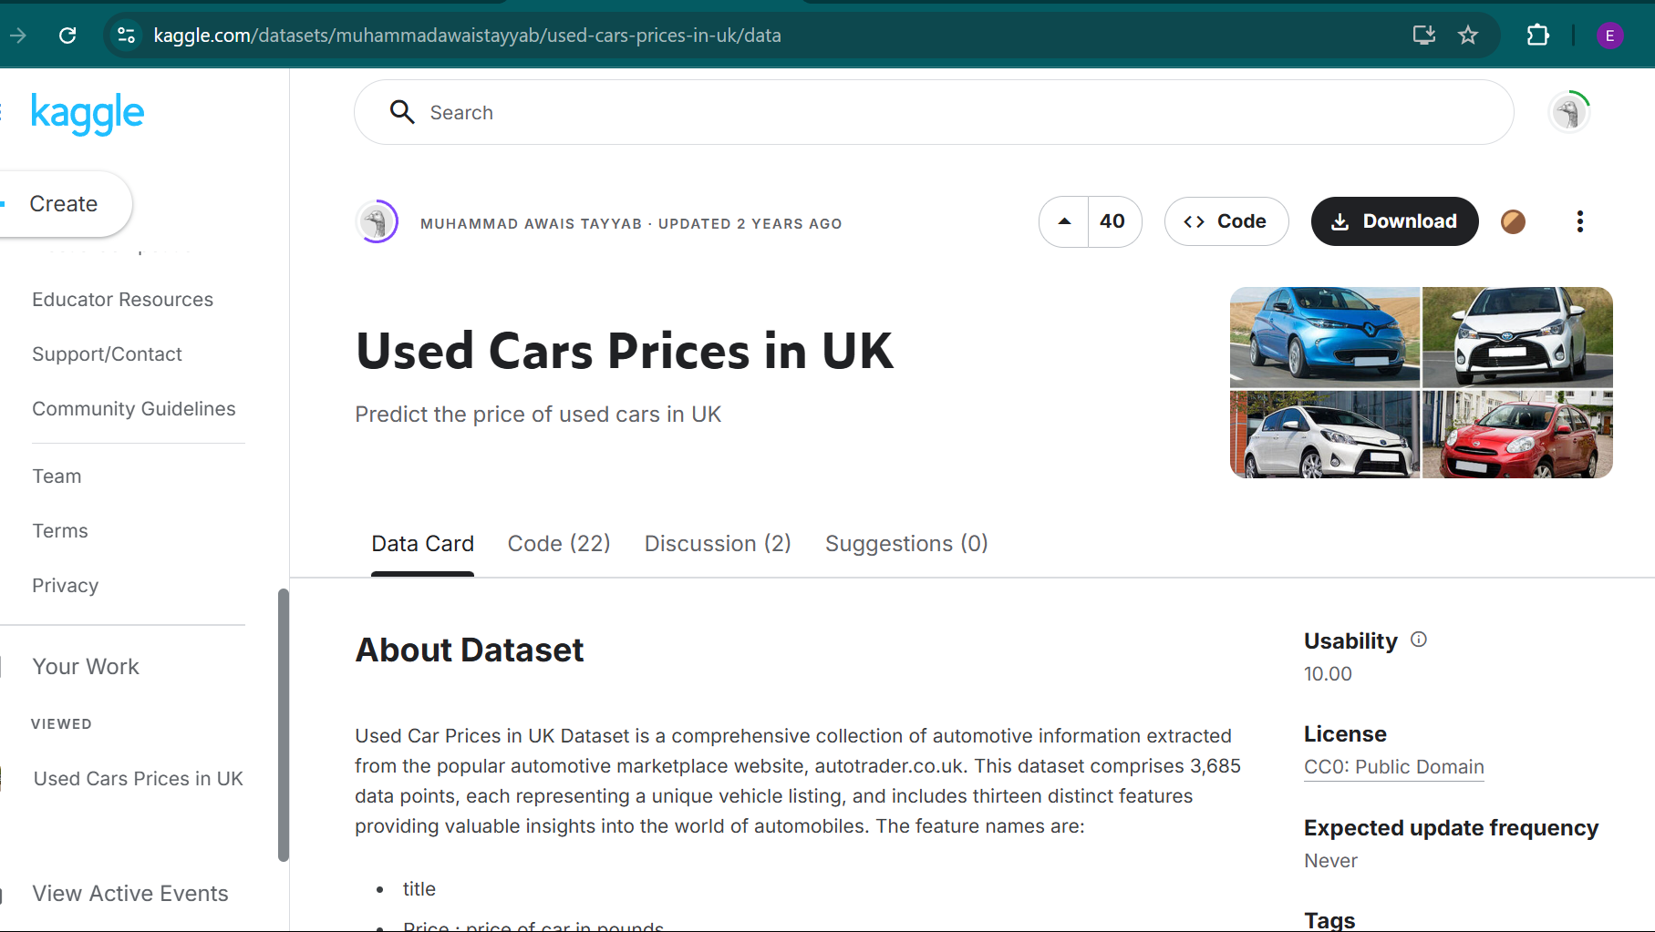
Dataset Source

Slide 19
Stretch: Importing Directly into jupyter
(see Task 7; ‘what I would do differently’)
I ran this ChatGPT prompt;
‘walk me through step by step how to use Kaggle API to import data set directly into Jupyter in VS code in WSL, After each step await my confirmation of completion indicated with a simple '.' prompt from me before moving on to the next step, I would like you to briefly explain your thought processes along the way’
I have to say, this prompt had a very concise yet detailed output, the brief explanations with each step helped me understand what exactly I was doing throughout.
See coming slides for my solution (well… ChatGPT’s)

Slide 20
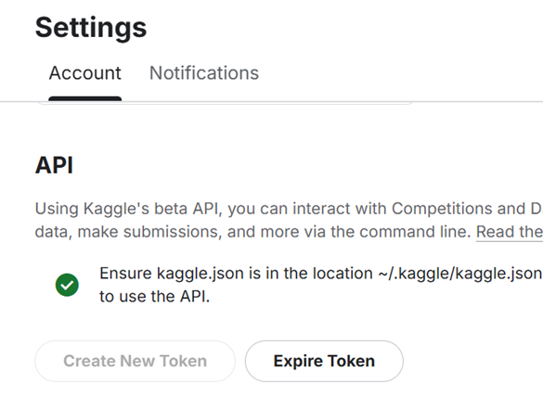
Creating API token

Slide 21
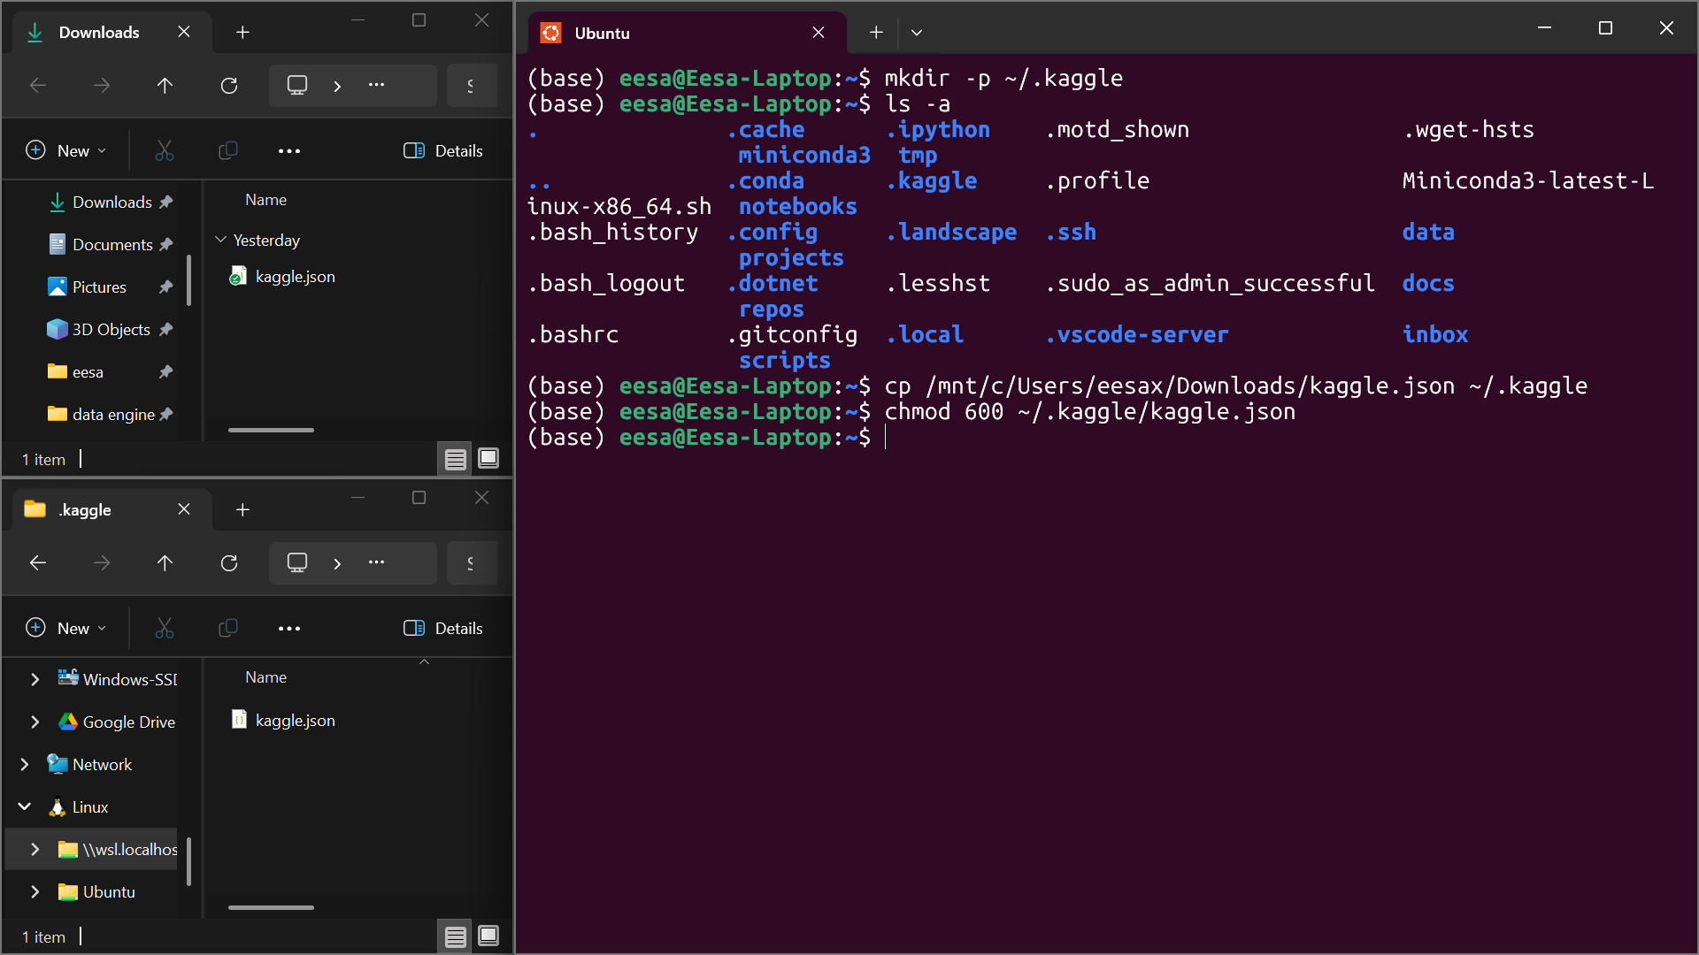
Adding Kaggle.Json to my WSL Environment
Over here, AI only provided me with the first and last lines in the terminal, I took the initiative to copy

Slide 22
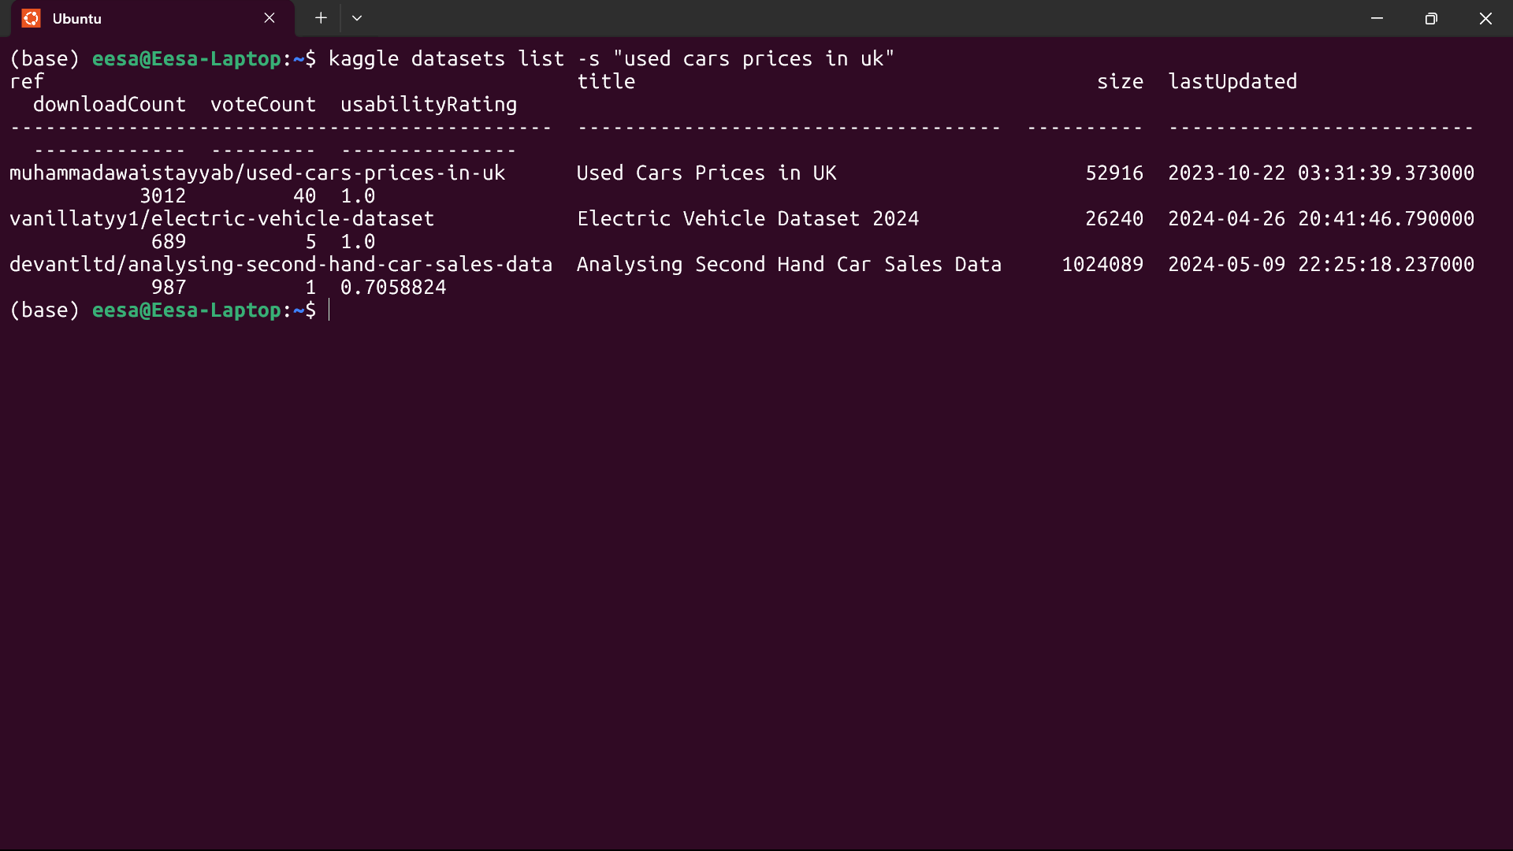
testing Kaggle API
(After Installing Kaggle with pip)
As you can see, I am now able to directly access Data sets from my terminal which I never knew was possible until today!!

Slide 23
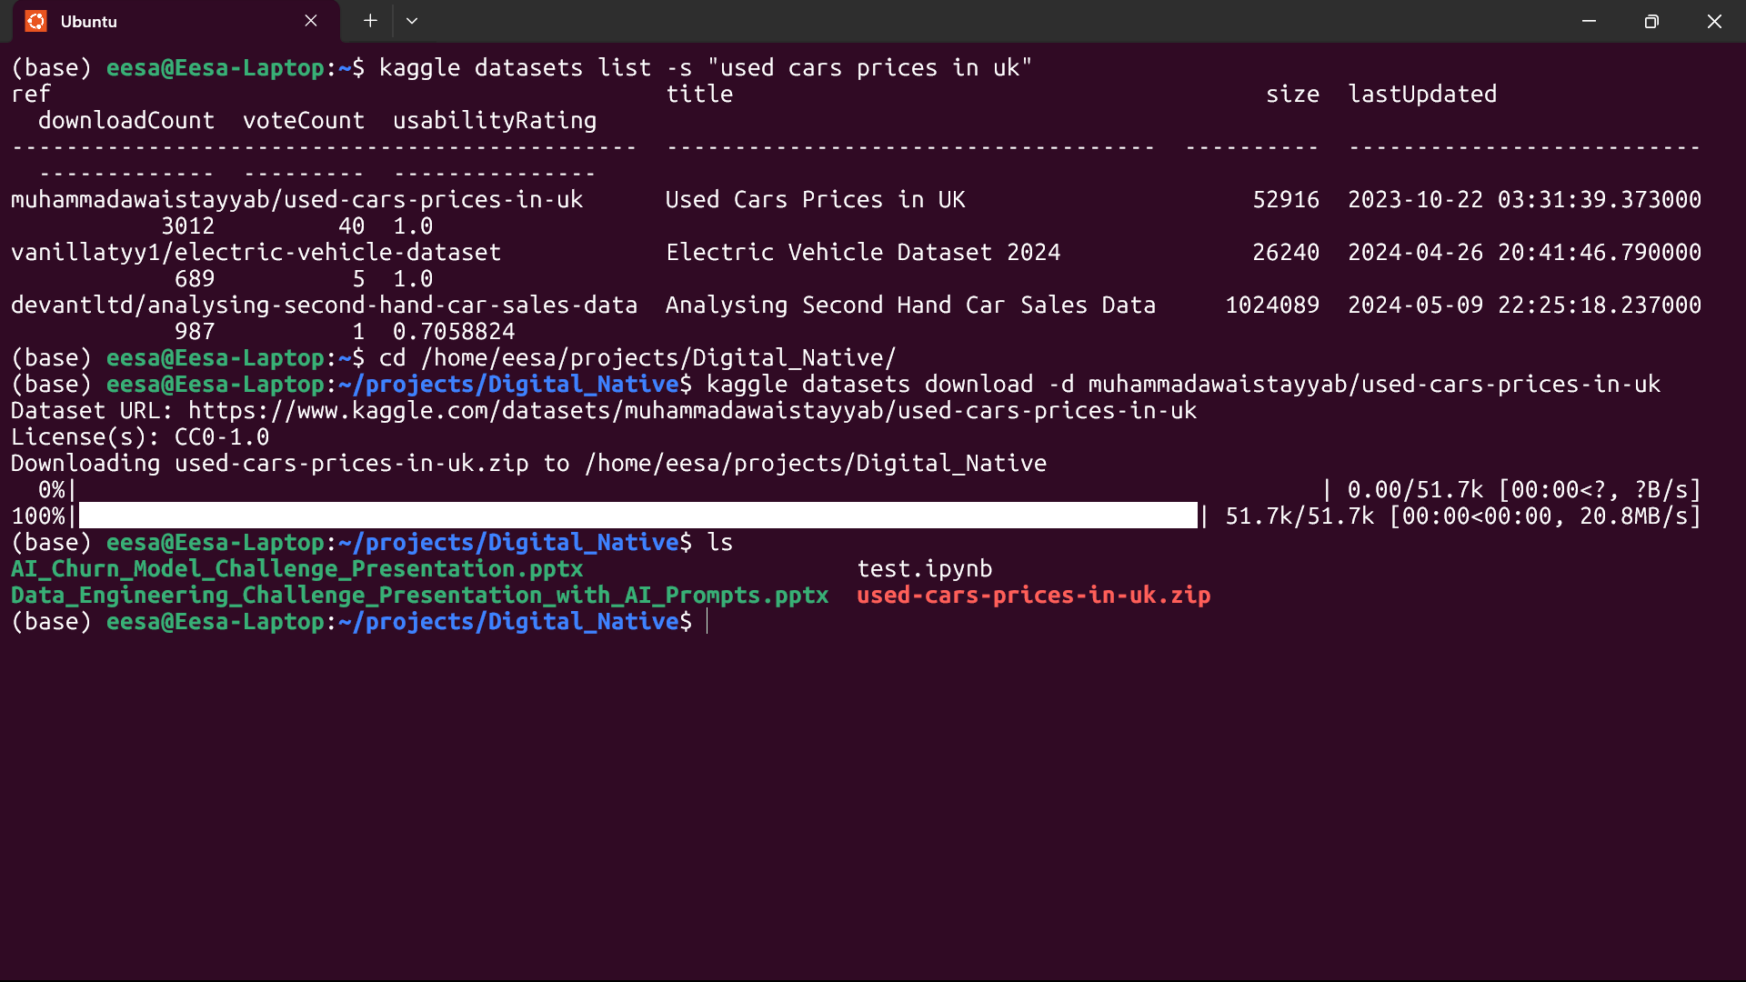
Downloading .zip file

Slide 24
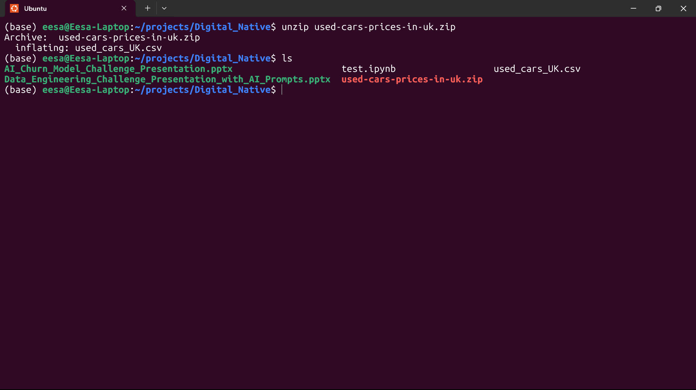
Extracting .csv from .zip file

Slide 25
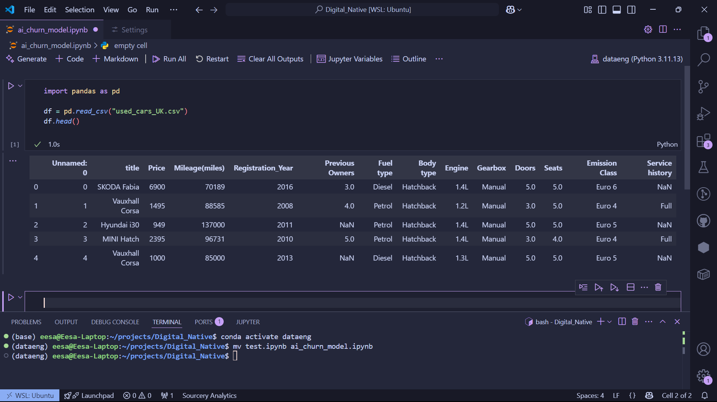
Loading set into jupyter notebook in vs code
(also checked the data with pandas head() function)

Slide 26
Task 3: Snowflake Account
Sign up
Documentation: Getting started with Snowflake
Notes:
Mention why region and language selection matters.

Slide 27
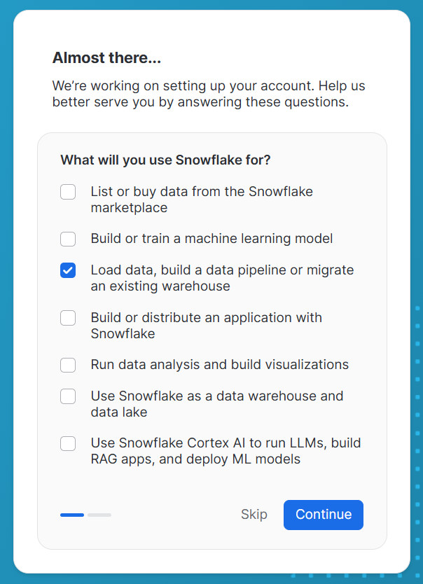
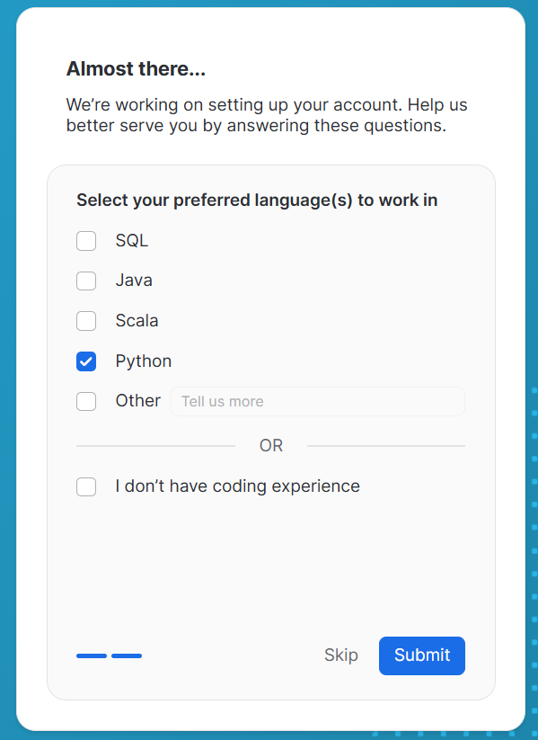
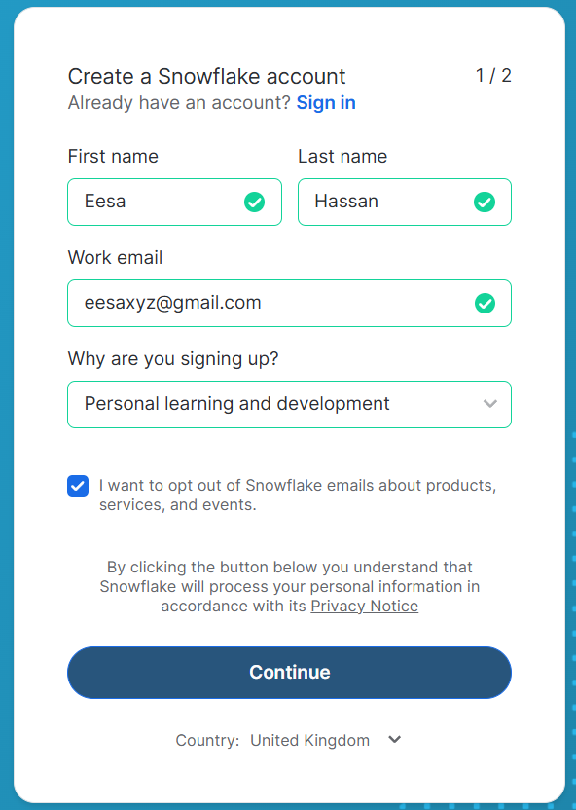
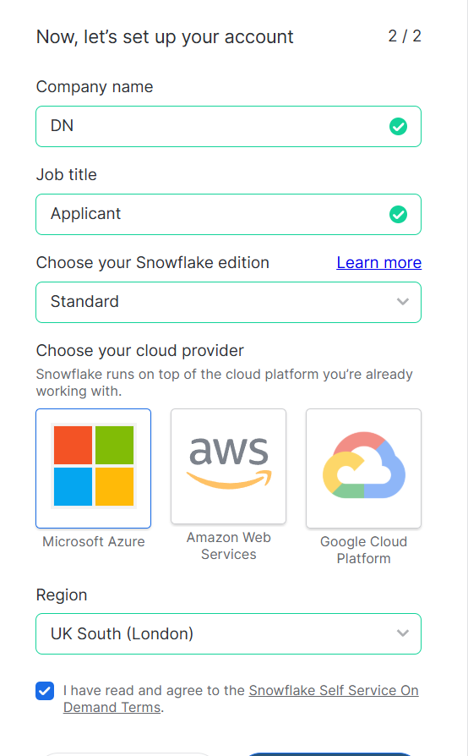
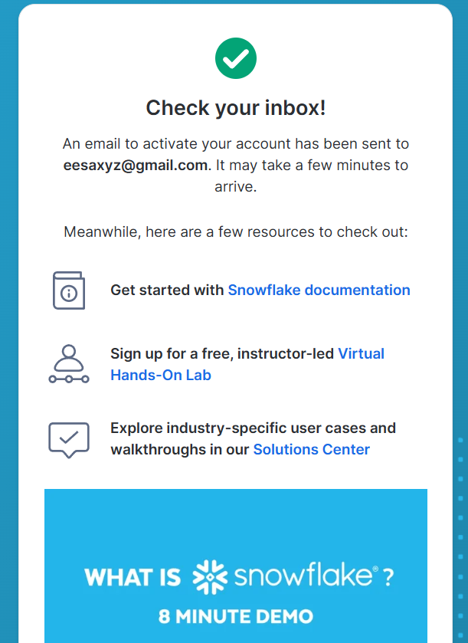
Singing up

Slide 28
Documentation: Getting started with Snowflake
I have already completed this tutorial during the "Read-Up" phase of my preparation. To stay focused on the current task, I will not include detailed documentation of the tutorial here.
For quick reference, the tutorial uses a fictional food truck brand named Tasty Bytes to demonstrate how to load and query data in Snowflake using Snowpark for Python. All tasks were performed using a pre-loaded Python worksheet within Snowsight.

Slide 29
Task 4: opening & combining Files
Importing/files + head() output
combining files (Clarification)
Stretch: other information about data set
Notes:
Add a row count post-merge, show code snippets.

Slide 30
Loading set into jupyter notebook in vs code
(already completed this in stretch challenge for task 2)

Slide 31
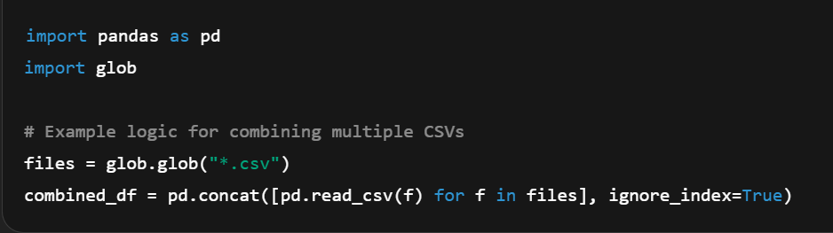
Combining Files (Clarification)
Although the instruction mentioned combining multiple files, the Kaggle dataset only contained one CSV file. (see task 7 ‘Problems and Fixes’)
This appeared to be a test of attention to detail.
What I would’ve done if there were multiple files:

Slide 32
Stretch: other information about data set
I ran this prompt in copilot for different information extraction methods:
‘give me some professional methods/practices a data engineer would use to find useful information about this csv file in pandas’
Then rather than letting copilot automatically implement them in my notebook, I manually typed them out myself (I find this way I can recall the functions from memory).
I included a few of them as follows…

Slide 33
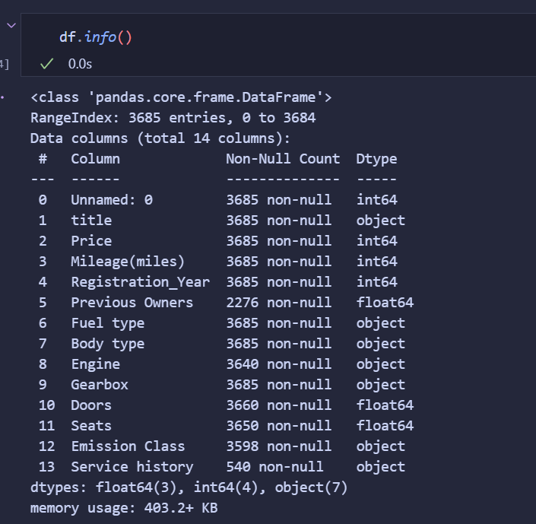
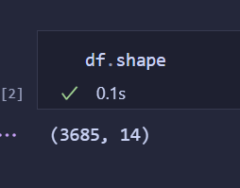
Check the shape of the data (number of rows and columns) to get an understanding of the data size
Key information about the data set columns (including column names, number of entries that aren’t null, and data types)

Slide 34
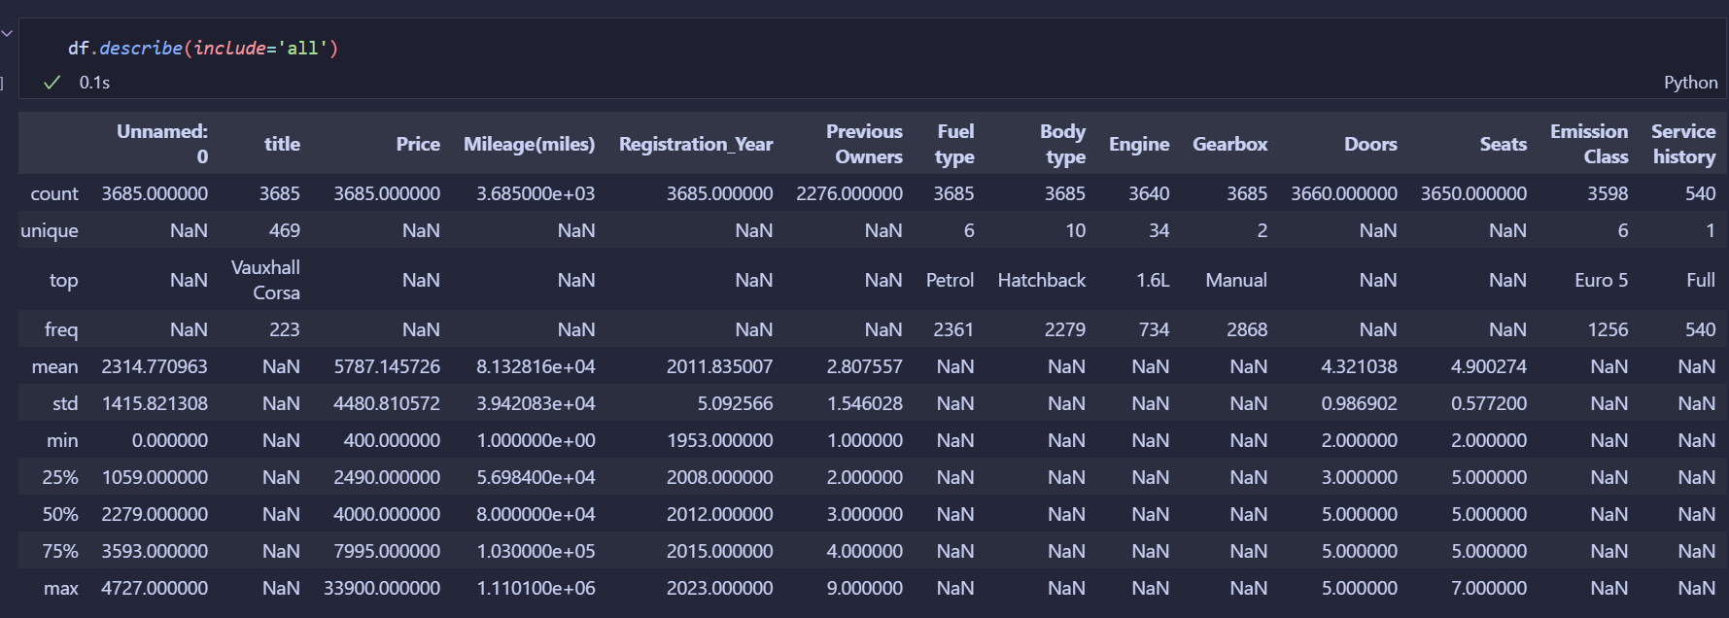
Provides a quick and comprehensive statistical summary of the Data.
This allows me to:
Understand the range and distribution of used cars attributes (e.g. cars registration year range from 1953 to 2023)
See the most common (top) attributes of used cars (e.g. most common fuel type is petrol)
Detect possible anomalies
Summarize both numeric and categorical columns

Slide 35
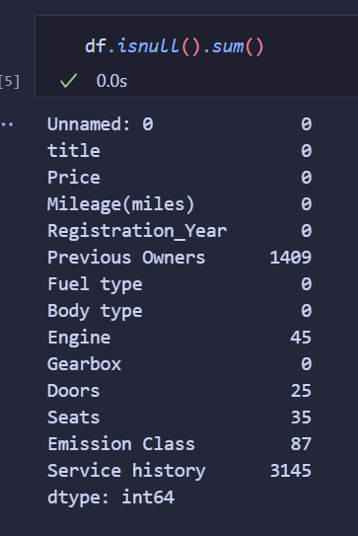
If I just wanted the number of missing values independently for each column then I could run this command.
This shows me that Previous Owners, Seats, Emission Class, and especially Service history have missing values

Slide 36
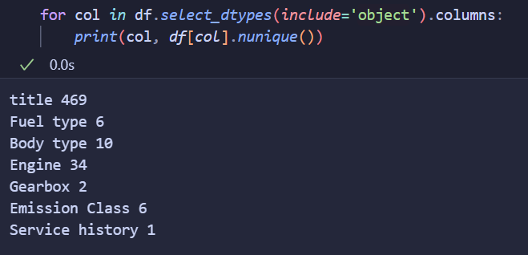
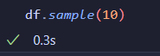
I ran this command to get an Idea of the number of unique values
I also sampled 10 random entries to understand the data more and what different values look like

Slide 37
Task 5: Identifying/Addressing Data Quality Issues
AI Guidance
Identifying Issues
Cleaning code
Before vs After screenshots
Notes:
Show issues like nulls, type mismatches, outliers. Mention AI prompts if used.

Slide 38
AI Guidance
I’ll be completely honest; I let AI plan take me through this entire task step by step, here's the prompt I ran:
‘This is my next task (Task 5): Identify and Address any Data Quality Issues Common Data Quality issues include:
• Missing data, • Data of the wrong type or format, • Outliers
I want you to:
- Research the common data quality issues listed above + 2 more and how to identify them (all 5) in Python.
- Research how to remove any records with data quality issues from the combined data set.
- Explain why I should remove the records from the data set
please start from the 'research common data quality...' and work your way through step by step, I want you to wait until I am done with a step before proceeding to the next step on my command indicated by a simple '.' prompt, if you need any more information for better results then request it from me (and include it as a step) before starting a step.
For context; I am working with a csv file that I imported from kaggle into jupyter notebook in vscode in wsl and am using python and pandas to view the data. ’

Slide 39

identifying Issues

Slide 40
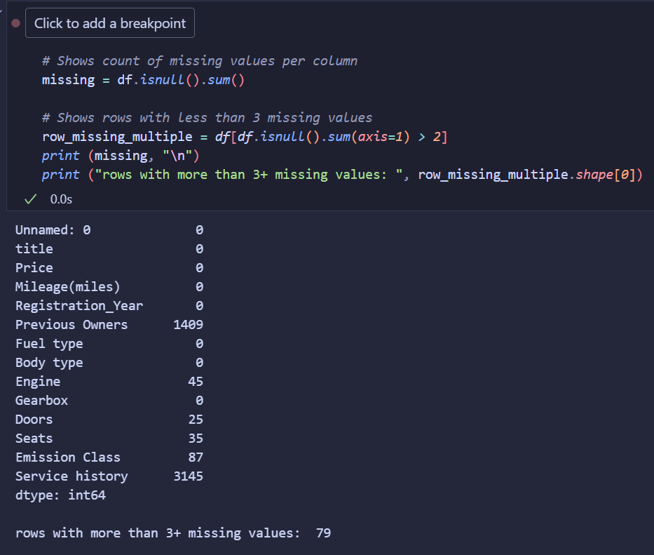
1. Missing Data
(Included in Task 4: additional information stretch challenge)
This shows a summary of the number of missing values for each column.
Additionally, it shows the number of rows with 3 or more missing values.
I chose ‘3 or more’ because of the rows high percentage of missing ‘Service history’ and ‘Previous Owners’ values.

Slide 41
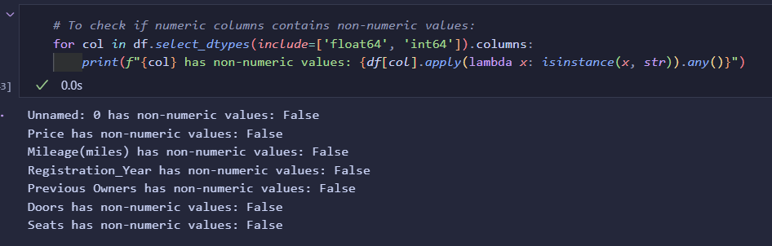
2. Data of the Wrong Type or Format
I checked if any of the numeric columns had non-numeric values; in which they all returned False.
(AI initially gave me code that only tested for a single specified column, I prompted AI to include all numeric columns)

Slide 42
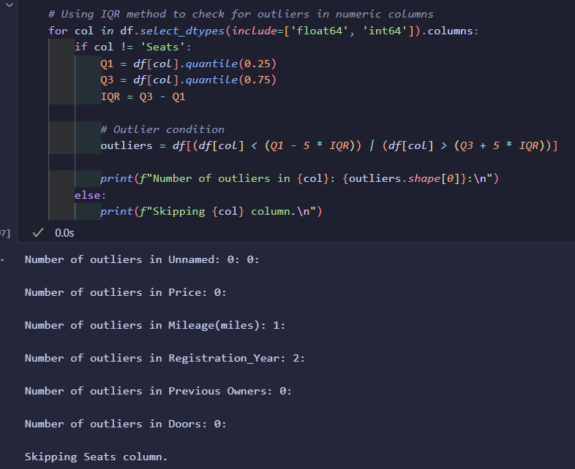
3. Outliers
(Test 1)
AI initially made me use 1.5 * IQR rule to test for outliers.
I found that this included values that were too ‘normal’ (by my standards) to be classed as anomalies.
Therefore, I change the multiplier to 4 and ended up with more sensible values being removed.
To see outlier values, I ran:
print(outliers[col], "\n")

Slide 43
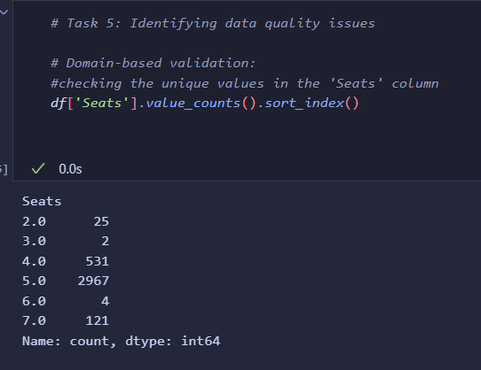
3. Outliers
(Test 2)
I Manually tested for outliers in the ‘Seats’ column by checking for unique values.
A car can typically have between 2 and 9 seats (if mini-vans are included) so no anomalies here.
(Values ranged from 2 - 7)

Slide 44
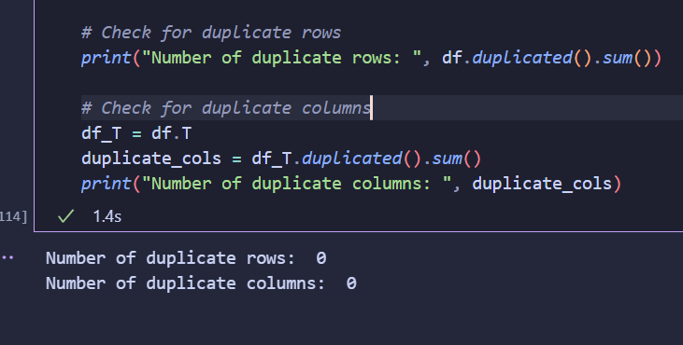
4. Duplicated Records
AI oddly expected me to check for duplicates separately for each column, so I prompted AI to change the code and include all columns

Slide 45
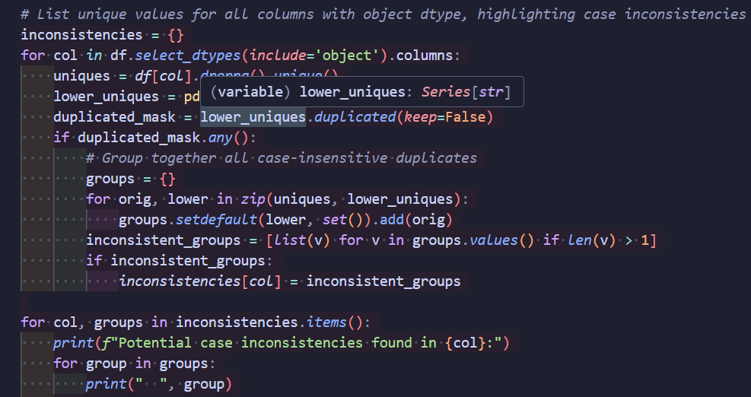
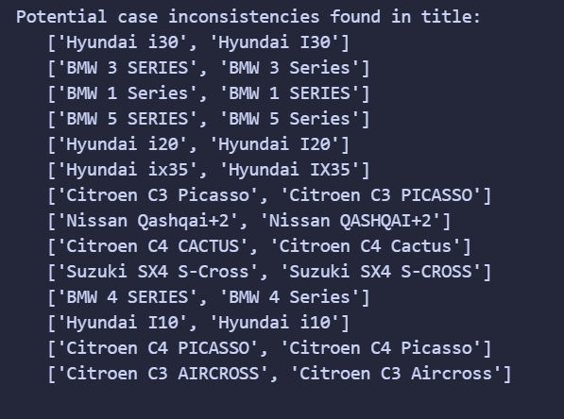
5. Inconsistent Categorical Values
I used this to check for and list all values in columns (with an object data type) that had case inconsistencies
AI Initially gave me one big list with all the possible inconsistencies; I used copilot to sort/group them together.

Slide 46
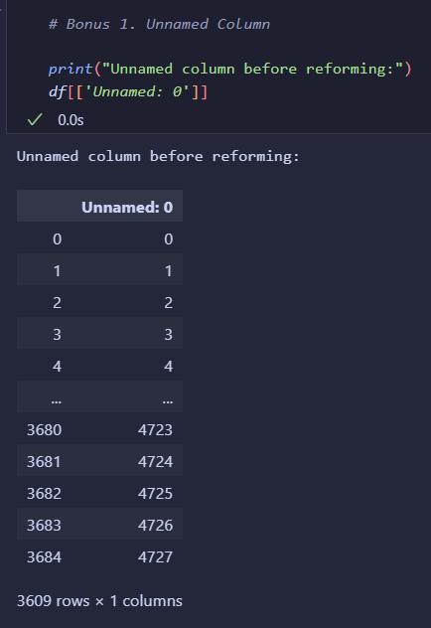
Bonus 1. unnamed Column
The Unnamed column appears to be a number indexing column.
At the top of the column, it is equal to the in-built pandas row indexing.
However, at the bottom it has changed and doesn’t match?
I opened the csv and checked the numbers; it appears that some increments have been skipped out.

Slide 47
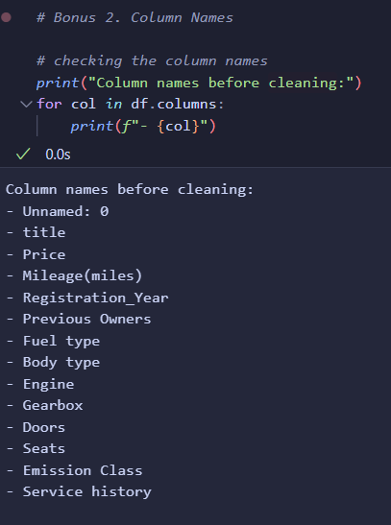
Bonus 2. column names
I also noticed that the column names use different cases, be it Camel, Pascal, or Snake Case.
Since column names are case sensitive in pandas, it’s probably a good idea to have them all uniform.

Slide 48

Cleaning code

Slide 49
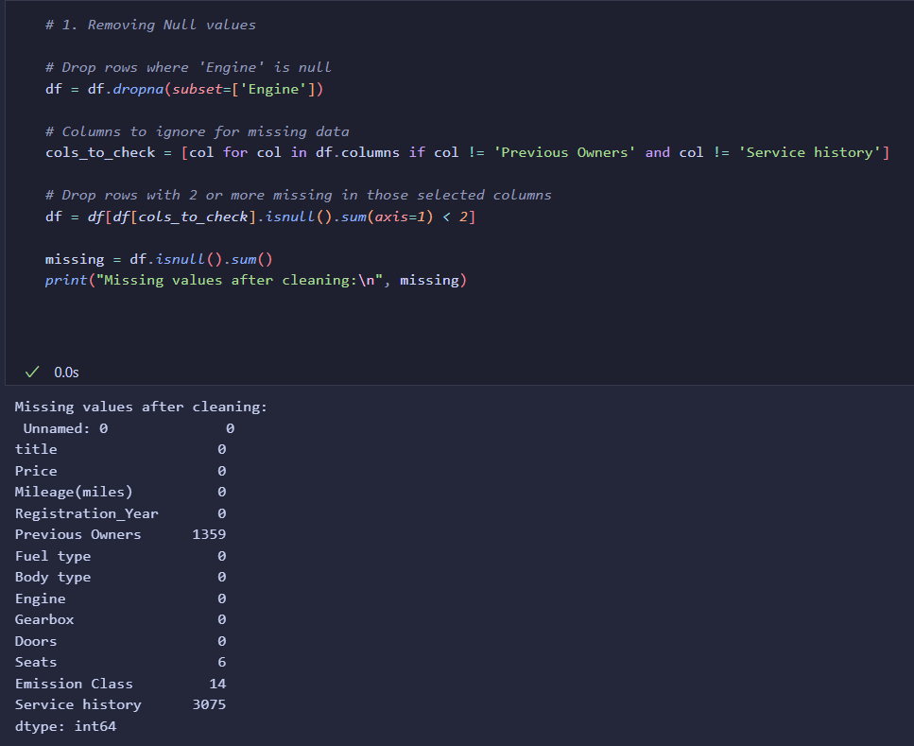
1. Removing Null values
I removed all rows that didn’t have ‘Engine’ values (due to importance of the information according to AI and Google).
I also removed any rows that had 2 or more missing values not including 'Previous Owners' and 'Service history’ columns (due to there high percentage of null values and lack of importance)

Slide 50
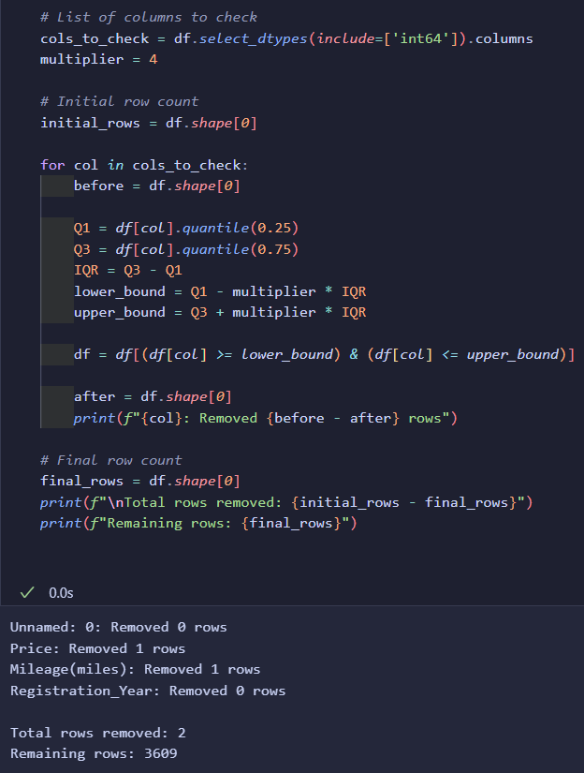
2. Removing outliers
I used the same method for searching for outliers earlier.
The only difference was that I removed all outliers strictly in ‘int64’ type columns.
This was to avoid any errors or conflicts when filtering using the IQR method.

Slide 51
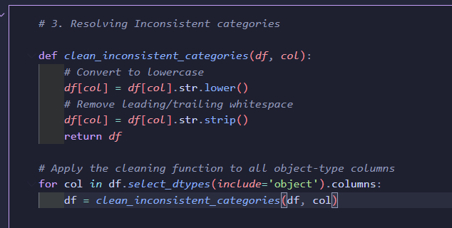
3. Resolving Inconsistent categories
For each object type column, I converted all the values to lower-case and stripped any trailing blank spaces

Slide 52
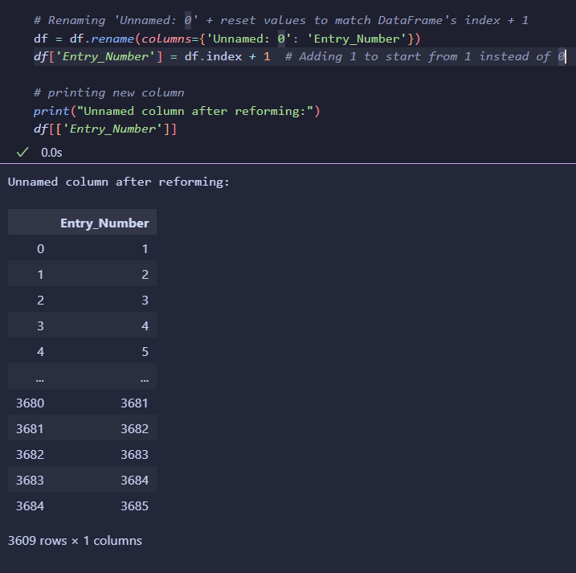
4. Reforming Unnamed column
I Changed the column name to ‘Entry_Number’ and asked Copilot to match the entry number indexing with the existing Dataframe’s indexing +1 (so that the first entry is numbered 1 rather than 0).

Slide 53
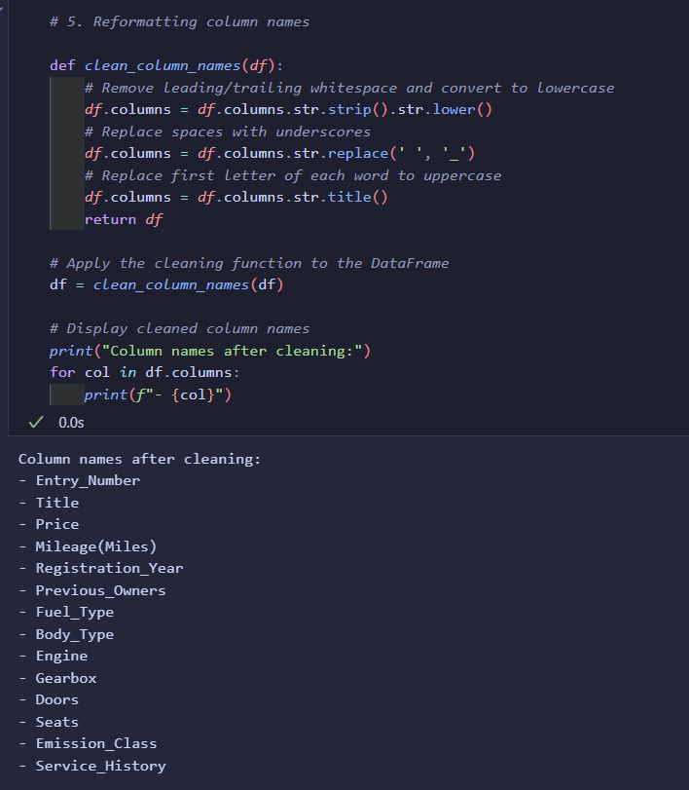
5. Reformatting column names
How I formatted the names:
- I stripped any trailing blank spaces
- Replaced the spaces between words with underscores
- Replaced the first letter of each word with uppercase

Slide 54

Before vs After screenshots

Slide 55
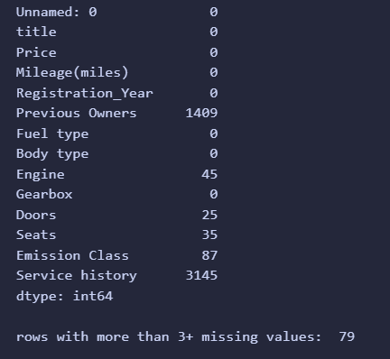
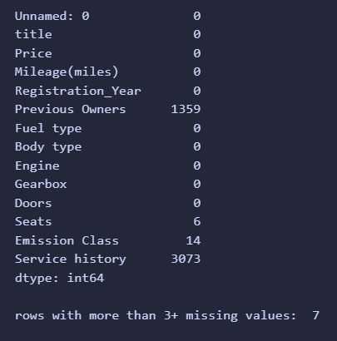
Null values
Before
After

Slide 56
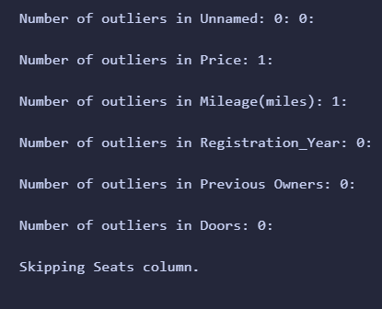
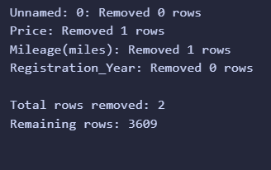
outliers
Before
After

Slide 57
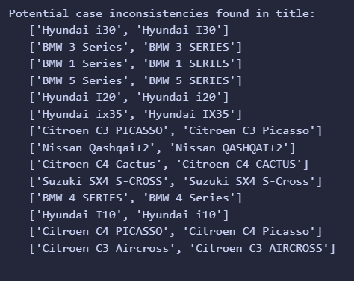
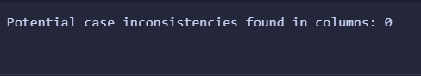
Inconsistent categories
Before
After

Slide 58
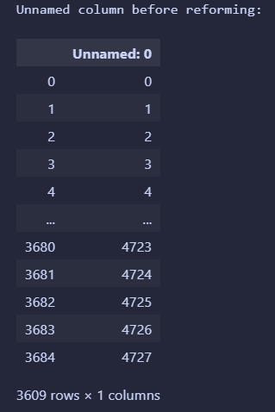

Unnamed column
Before
After

Slide 59


Column Names
Before
After

Slide 60
Task 6: Snowflake DB Load
Environment Setup
Defining connection to snowflake
Creating session (root object)
Verifying the connection
Creating the database
Converting & Loading to Snowflake
Validating the Upload
Database in Snowflake Screenshot
Notes:
If you used Snowpark or `snowflake.connector`, explain it.

Slide 61
Environment Setup

Slide 62

Defining connection to snowflake
I decided use a Python dictionary rather than a configuration file since it was more suitable for this challenge (asked AI).
I used AI to walk me through and explain each parameter so I can understand what I’m dealing with.
Wasn’t sure if I should use any database or create a new one (see Task 7; ‘Problems & Fixes’)

Slide 63

Creating session (root object)

Slide 64

Verifying the connection
I verified the session context to ensure it was connected to the correct warehouse, database, and schema.

Slide 65

Creating the database
I created a dedicated database with SQL instead of python (for SQL practice) to store the data, then I switched the session to the newly created one and ensured the schema was public

Slide 66

Converting & Loading to Snowflake
I loaded my pandas DataFrame into a new Snowflake table named ‘USED_CAR_PRICES_TABLE’ using the Snowpark integration, which auto-creates the schema.

Slide 67

Validating the Upload
I validated that the data was successfully uploaded by inspecting sample rows and counting the total records. (matched the total in pandas after data cleansing)

Slide 68

Database in Snowflake Screenshot
FINISHED!!!
gotta give myself a pat on the back (and a little sweet treat ☺)

Slide 69
Task 7: Learnings & Reflections
What I’ve Learnt
Problems & How I Solved Them (Fixes)
Business Use Case: Why this matters
What I Found Difficult
What I Would Do Differently
Do I Still Want A Data Engineer Career?
Notes:
Include personal insights, business relevance, and your learning process.

Slide 70
What I’ve learnt
Using Miniconda in WSL
Setting up Conda environments
Creating Jupyter Notebooks in VS code
Importing datasets directly into Jupyter Notebook from Kaggle API
Importing, Reading, and Combining data files using Pandas
Analysing data sets using Pandas
Identifying/addressing data quality issues using Pandas
Importing pandas table into Snowflake using Python
Learning the basics of Prompt Engineering
Bonus: Completing a valuable project to showcase in my portfolio
Never in my life did I think I would gain so many skills in such a short time…

Slide 71

Problems and fixes

Slide 72
1. Conda environment error
After opening a notebook in VS Code, I tried to run a test print command however it prompted me to create an environment
the conda environment set up was failing because I was in WSL (Troubleshooted using copilot)
Using ChatGPT I compared miniconda in WSL vs anaconda in Windows and listed the pros/cons
Summary: using WSL environment for everything is better for long-term data engineering career development.
Since I already use WSL for my projects, I decided to reinstall miniconda for WSL

Slide 73


2. Kaggle HyperLink fault
I noticed that every time I clicked on the Kaggle.com hyperlink (in the challenge pdf provided),
it would take me to a Microsoft online sign in page.
So, I double checked it wasn’t me and inspected the html elements,
then I asked the inbuilt google ai assistance to show me the URL attached and…
GAI failed me ☹
I ended up just manually searching ‘kaggle.com’

Slide 74


3. Task 4 mistake?
In task 4, it mentions how to import a single file before prompting the applicant to figure out how to combine all the files…
However, the data set on Kaggle only has one single CSV file.
I quickly made a few checks (see next slides)…

Slide 75

1st: Inspecting zip file
To verify I inspected the downloaded ZIP file and found only one CSV file.

Slide 76



2^{nd:} checking data set update status
The screenshot provided in the PDF (left) matched the current update status (right)

Slide 77

5. Issue Checking outliers
(Task 5)
While checking outliers I noticed that all car doors with values above 3 were showing up which can’t be right.
I asked AI for the reason and a fix, and it returned…
‘The IQR method assumes a continuous distribution (like price or mileage)…
Use domain-based validation, not IQR’
So, I ended up using two methods of validation to test for outliers (see Task 5: Outliers)
The way I checked what the outlier values were was by running:
print(outliers[col], "\n")
And then opening in a txt file due to output being truncated (result of large outputs).

Slide 78


Task 7: Wrong order of instructions?
The instructions in the PDF (Digital Native challenge) tells you to define the connection to snowflake first, then to create the database.
However, one of the parameters for the snowflake connection is the database name which hasn’t been created yet?
To double check, I asked ChatGPT if there was a reason behind this and…

Slide 79
Business Use Case: Why this matters
Supply & Demand: Identify which car makes, models, and specs are most common, understanding customer demand.
Used Vehicle Pricing Insights: Track price trends across car brands, fuel types, and regions.
Price Prediction: Using the price insights (above) a data scientist could potentially predict future model prices
Stock & Supply Chain Decisions Analyze which car types are more available or selling at higher prices, allowing for strategic inventory purchasing.
Data Source for Future ML Models Although this dataset doesn’t include user behavior (as I mentioned earlier- see ‘Wrong Title?’ in challenge overview), it could serve as a base to join with user activity or sales data later, enabling churn prediction, or customer profiling.
Improved Data Access via Cloud Warehousing Storing the data in Snowflake allows remote teams, analysts, and BI tools to access a single clean version of the dataset, thus removing bottlenecks common with spreadsheet-based workflows.
My findings after some research…

Slide 80
What I found difficult
One of the most confusing parts of this challenge for me was connecting to Snowflake. The documentation was cluttered with links, multiple setup methods, and unfamiliar terminology like root object, warehouse, and Snowpark session.
While trying to follow the official steps, I struggled with understanding what was necessary vs. optional, especially around when to create databases, how to set up the connector, and connecting/create root object.
I also hit technical errors often, like syntax mistakes (especially when experimenting with pandas).
Despite these issues, I never truly got stuck. Every time I was unsure, I used AI (ChatGPT) to break things down line-by-line. This made even complex parts like environment setup, session config, and data loading feel manageable.
Over time, ChatGPT became both my teacher and debugger — explaining concepts like the difference between Snowpark and the Snowflake connector, what a "root object" really is, and why Snowflake uses a compute warehouse.
This approach of combining official tools with AI support helped me move forward efficiently, even though this was my first time using Snowflake professionally.

Slide 81

What I would do differently

Slide 82

Importing data Directly into Jupyter Notebook from kaggle
I realised after completing the first stretch challenge (Task 2) that it wasn’t the right method.
How I realised:
- After proof-reading my documentation and viewing the AI prompted steps I followed, it didn’t seem like I had directly imported into Kaggle…
- I asked ChatGPT to double check that the method it gave me was correct…
- ChatGPT realised it had made a mistake recreated the solution/steps which was as follows…
This is a good LESSON LEARNT for future tasks;
NEVER take GAI’s first answer as your final, and make sure to DOUBLE-CHECK always.
GAI is always prone to errors
SO SIMPLE!!!

Slide 83
2nd Outliers test
I should have included (‘Previous Owners’ and ‘Doors’ column’s) in my second outlier's test as they also have low ranges (Like the ‘Seats’ column)
This would’ve allowed me to check for anomalies with a preferable method (rather than using the IQR method which mostly works for higher ranges).

Slide 84
Data Visualisation
I should have incorporated data visualisation using Python libraries like the pandas built-in plotting or Matplotlib.
Visualising the data would have helped me better understand patterns, detect anomalies, and validate data quality before loading it into Snowflake.
This step would have probably improved my overall workflow efficiency.

Slide 85
Database & table management
Firstly, For some reason I created an entire dedicated database for one table (USED_CAR_PRICES_TABLE).
After I send this challenge, I’m going to make a new database for all my python projects and include this table in there (it’s really bugging me!).
Secondly, I don’t know why but I named the database and table with the longest possible name!
I will be renaming them afterwards for sure.

Slide 86
Do I Still Want A Data Engineer Career?
After completing this challenge, I’m more certain than ever that I want a career in data engineering.
I genuinely enjoyed the entire process — not just the technical problem-solving, but the clarity, structure, and creativity it required.
What stood out most was that it never felt like a chore; it felt more like a hobby I looked forward to each day. Even the complex parts didn’t stress me out — they just made me more curious. Every step taught me something new, and that sense of progress was deeply satisfying.
If this is a glimpse of what data engineering looks like, then I’m all in!
By ChatGPT… oops — I mean, Eesa On a serious note, these are genuinely my real thoughts. I just used AI to help me express them clearly.

